Slide 1


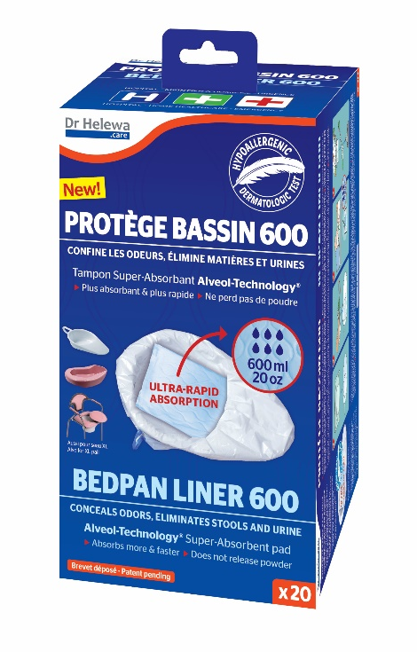
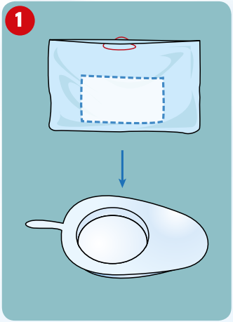
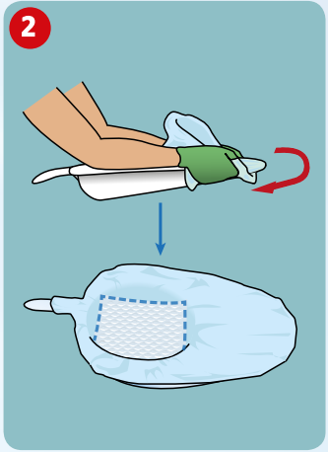
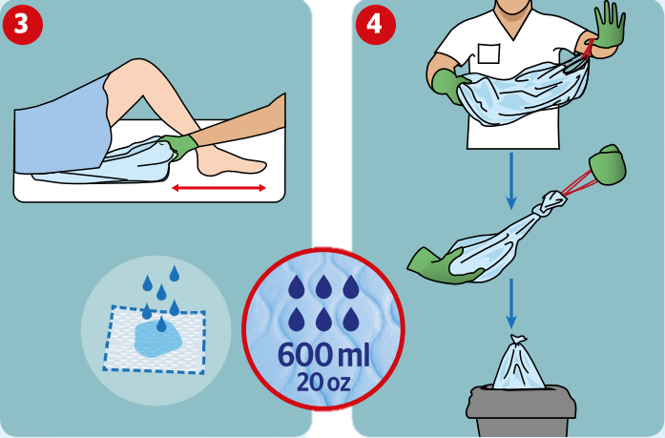
PROTOCOL - BEDPAN LINER
Description | Hygienic, single use liner with easy-to-pull ties enclosing a super absorbent pad for stools, urine and biological fluids. Medical device class I – CE
Recommended for | Follow-up care and rehabilitation Emergency medical transportation Patients in isolation Intensive care Resuscitation Gastrointestinal surgery Recovery room A&E Maternity
Precautions of use | Wear appropriate PPE (gloves, single use apron) Use and dispose of according to your facility guidelines. Do not flush Plastic bags cause suffocation, keep out of the reach of children
Instructions For Use
Open the box and tear the first liner off the roll
Place the liner on the bedpan. The liner protects the entire bedpan. The pad is at the bottom of the covered pan (absorption up to 600 ml/20 oz of biological fluids)
Position under the patient’s buttocks. The patient performs body functions.
Remove the used liner, pull on the drawstrings and knot them. If necessary, tie a knot in the bag itself. Dispose of in the household waste or according to the facility protocol (hazardous waste in case of infections).
DIDACTIC SAS - ZA A29 Les Bleuets, 1800 Route des Bleuets, 76430 Etainhus, France - RCS 370 500 142.
Medical device class I – CE, read the information on the box carefully. Version EN V1-01-2020

